Slide 1
Understanding the Black Death

Slide 2
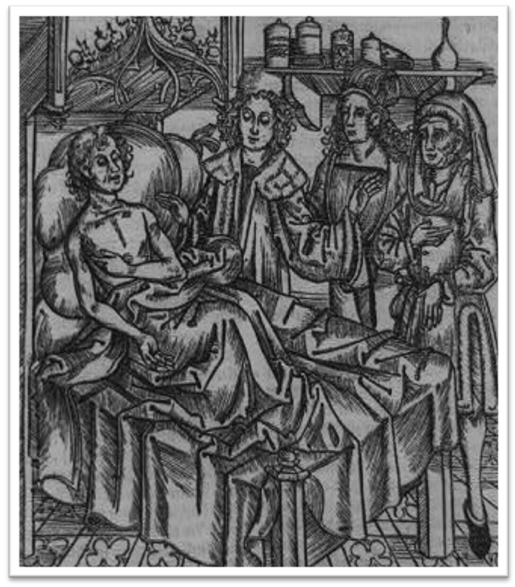
The Black Death
Illustration of plague victim published in 1500
Notes:
Image retrieved from http://www.loc.gov/pictures/item/92517397/

Slide 3
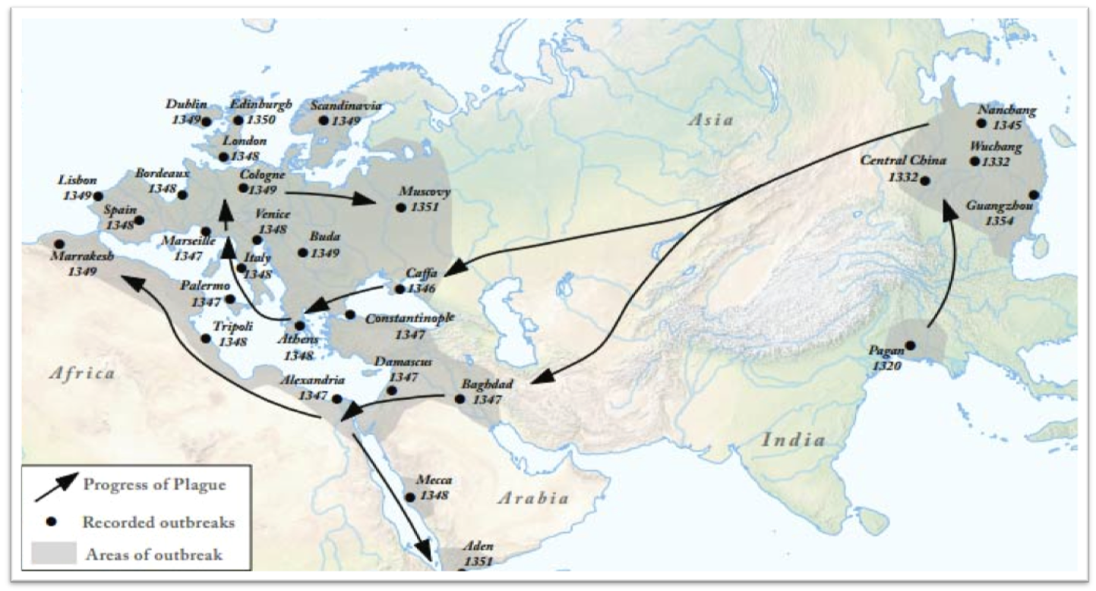
Spread of the Plague
Spread of the Black Death through Afro-Eurasia
Notes:
Image from retrieved from http://worldhistoryforusall.sdsu.edu/eras/era5.php.

Slide 4
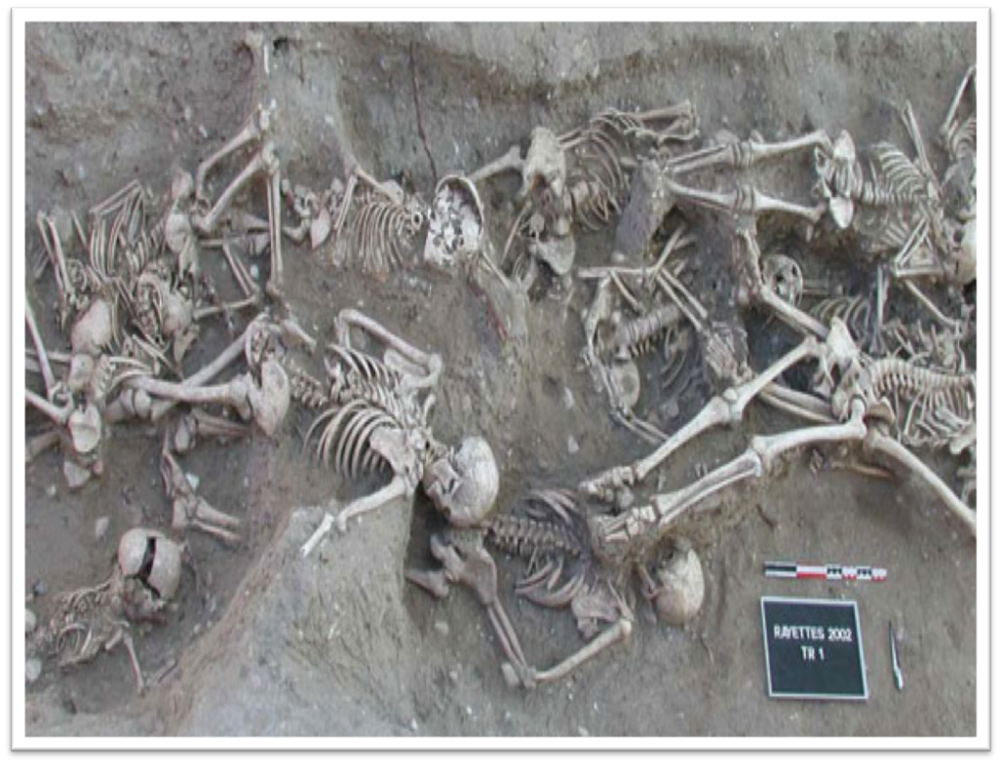
Human Costs
Excavated Mass Grave of Plague Victims
Martigues, France
Notes:
Image retrieved from http://en.wikipedia.org/wiki/File:Bubonic_plague_victims-mass_grave_in_Martigues,_France_1720-1721.jpg.

Slide 5
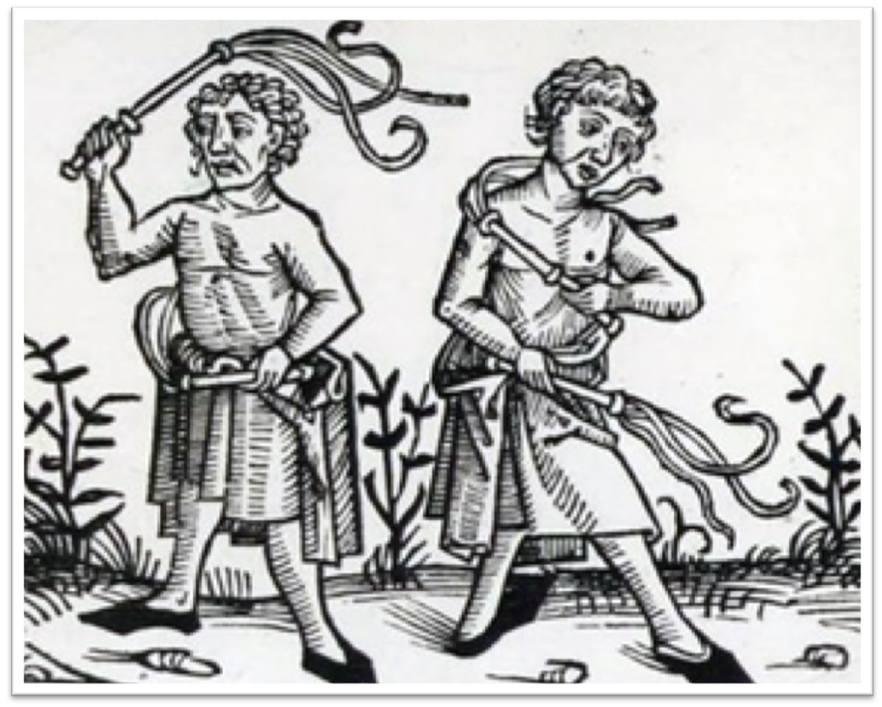
Understanding and Explaining the Plague
Flagellants from a 15th Century Woodcut
Notes:
Image retrieved from http://en.wikipedia.org/wiki/File:Flagellants.png.

Slide 6
Central Historical Question
How did people in the 14th century understand the Black Death?

